Slide 1
Retail POS Case Study
Jatin Agrawal

Slide 2
Analysis Approach
Business Understanding
Data Understanding,
Data Cleaning & Manipulation
Model creation & evaluation
Recommendation

Slide 3
Business Understanding
The data is POS data where one row represents a item purchased. The data has been filtered for the
Data of a single SKU "JUMBO BAG RED RETROSPOT".
The data is for the sales for the December 2010 to December 2011
We can initially group the data based on month to find out the sales per month and then can see trends, seasonality to predict the sales of the product in next months

Slide 4
Data Understanding
InvoiceNumber represents the invoice no of the bill when the item was purchased
StockCode represents the code to internally identify the product
Description represents the item description
Quantity represents the quantity of the item purchased
invoice date represents the date on which the item was purchased
Unit Price represents the per unit price of the stock
Customer ID represents the internally identified code for the customer

Slide 5
Data Cleaning & Manipulation
The useful columns are quantity and Date of invoice which do not have any NA values
We have grouped the data based on Months and converted the data to a timeseries

Slide 6
Test Harness
In the data set we have 12 rows containing the sales of the respective months.
We will draw the time series model using this data .
We will validate the model by finding the error after modelling the trend and seasonallity

Slide 7
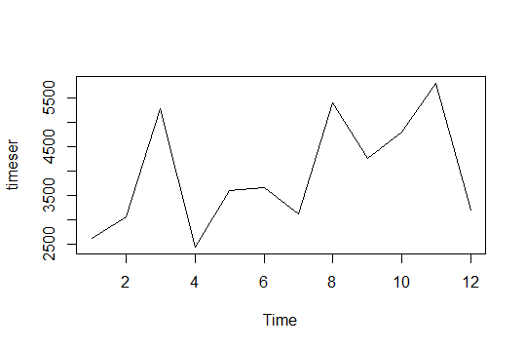
The x- axis represents the time in months The y-axis represents the quantity of the products sold in that month
Time series Model

Slide 8
Time series Model
In the data we can see that there is a trend of growth in sales.
There is seasonality where the sales increases every 2 months.

Slide 9
Linear Model
We attempt to draw a linear model between the time and quantity to find out the upward trend of sales quantity in the data.
Using the lm() function, we draw a model but all the parameters are insignificant.

Slide 10
Seasonality model
We have taken the cosine of the quantity and attempt to draw a linear model using the lm() function.
Using the lm() function, the variables have found to be insignificant.
We infer that there is no significant seasonality in the data

Slide 11
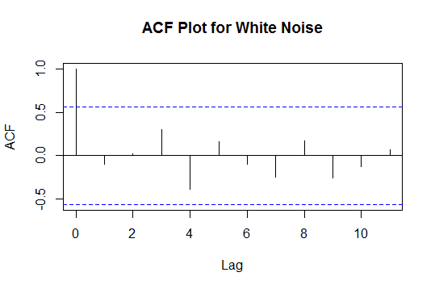
White Noise
acf(online_month$quantity, level=95, lag.max=12, main="ACF Plot for White Noise")

Slide 12
Conclusion
The data is a white noise and can not be used to make predictions for the sales of the company.

